Slide 1


Azərbaycan Dövlət Neft və Sənaye Universiteti
Calculus
Single Variable

Slide 2
Concavity and the Second Derivative Test

Slide 3
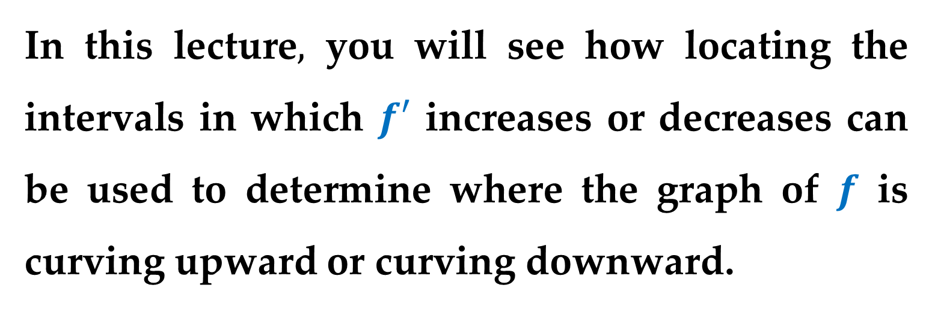
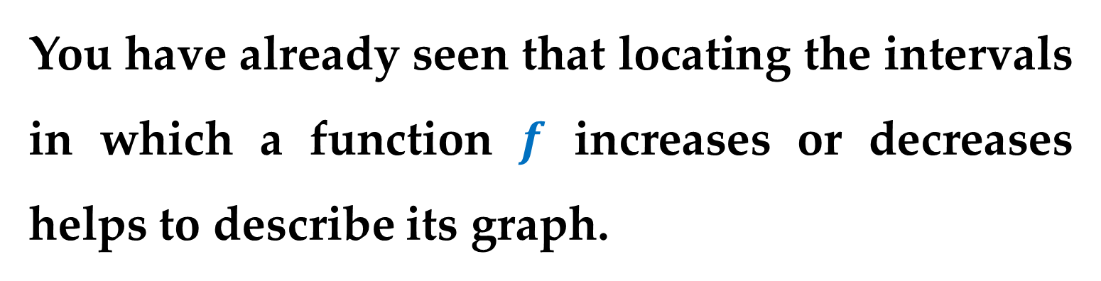
You have already seen that locating the intervals in which a function $f$ increases or decreases helps to describe its graph.
In this lecture$,$ you will see how locating the intervals in which $f′$ increases or decreases can be used to determine where the graph of $f$ is curving upward or curving downward.

Slide 4
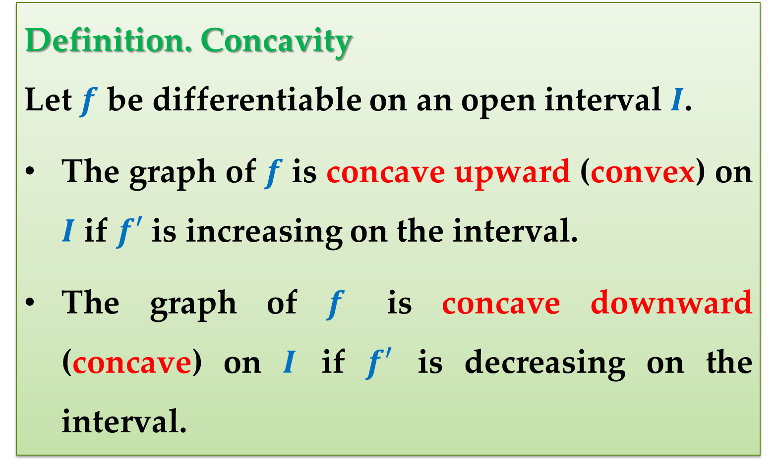
Definition. Concavity
Let $f$ be differentiable on an open interval $I$.
The graph of $f$ is concave upward (convex) on $I$ if $f′$ is increasing on the interval.
The graph of $f$ is concave downward (concave) on $I$ if $f′$ is decreasing on the interval.

Slide 5
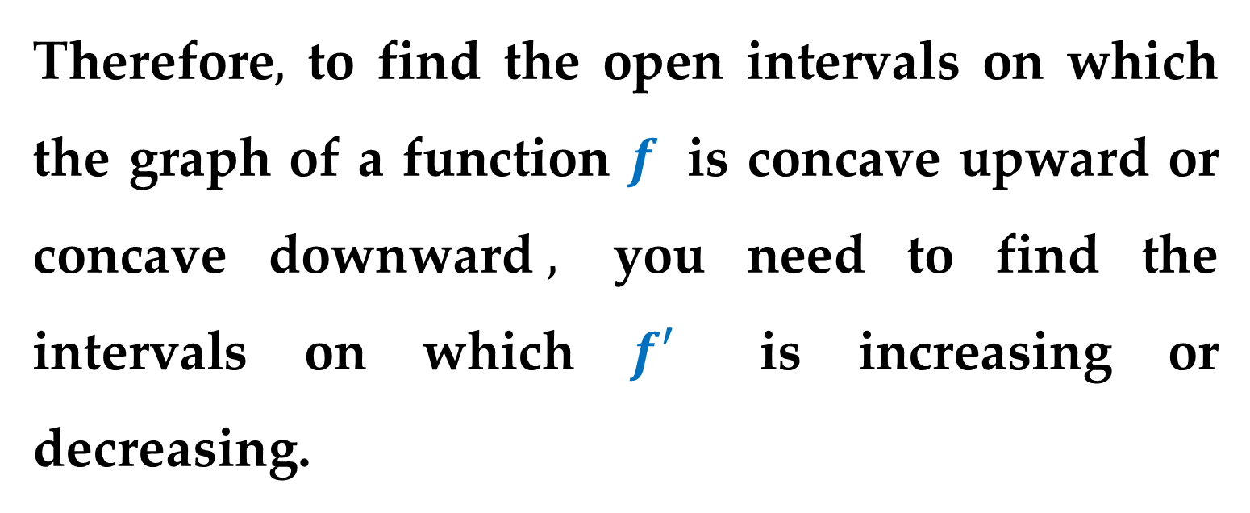
Therefore$,$ to find the open intervals on which the graph of a function $f$ is concave upward or concave downward$,$ you need to find the intervals on which $f′$ is increasing or decreasing.

Slide 6
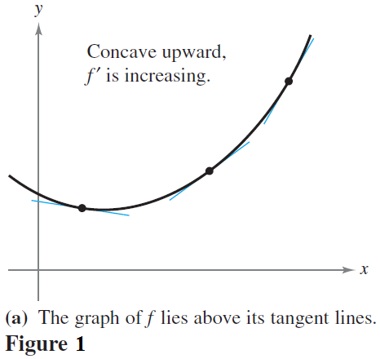
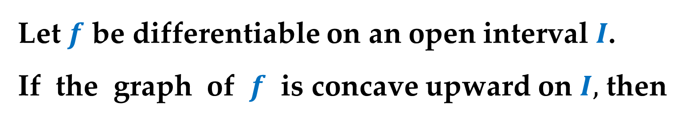
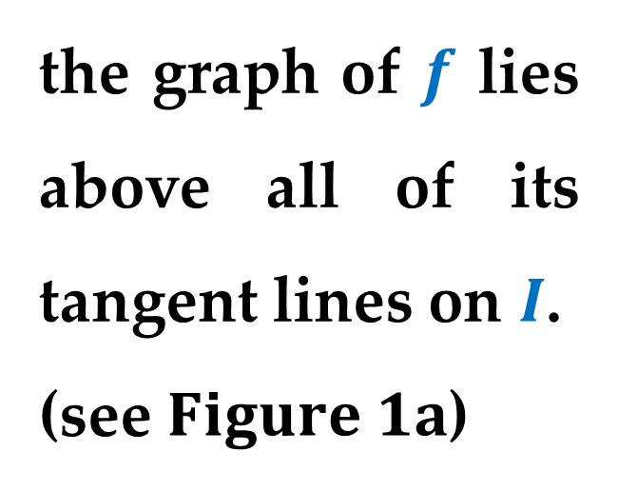
Graphical Interpretation - Concavity Upward
Let $f$ be differentiable on an open interval $I$.
If the graph of $f$ is concave upward on $I,$ then
the graph of $f$ lies above all of its tangent lines on $I$.
(see $Figure 1a$)

Slide 7
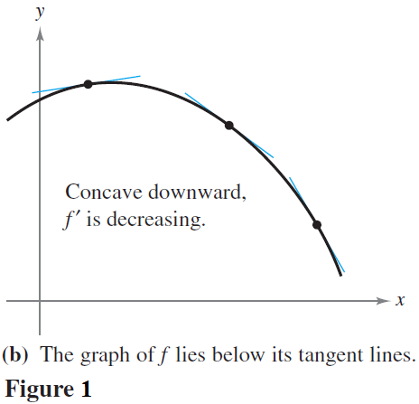
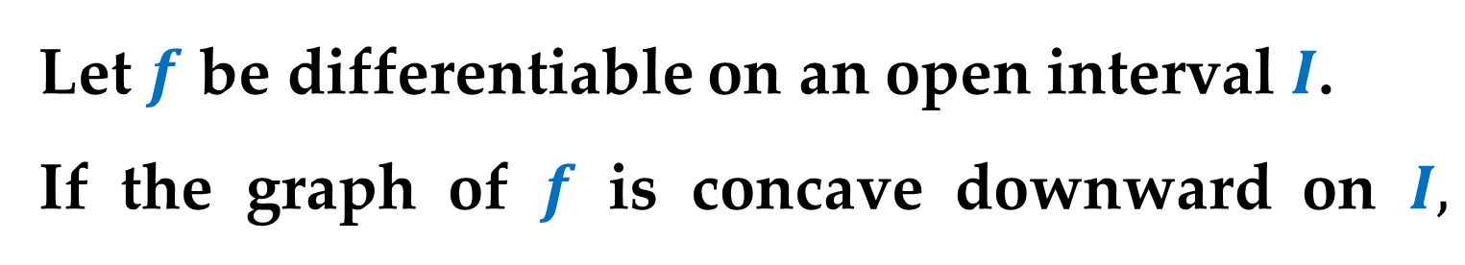
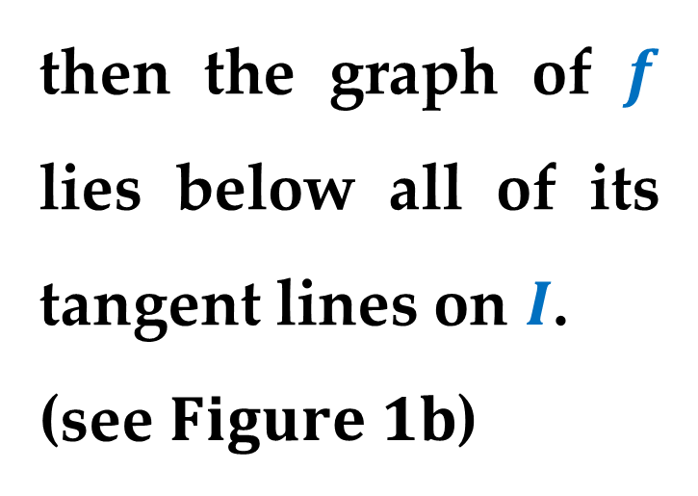
Graphical Interpretation - Concavity Downward
Let $f$ be differentiable on an open interval $I$.
If the graph of $f$ is concave downward on $I,$
then the graph of $f$ lies below all of its tangent lines on $I$.
(see $Figure 1b$)

Slide 8
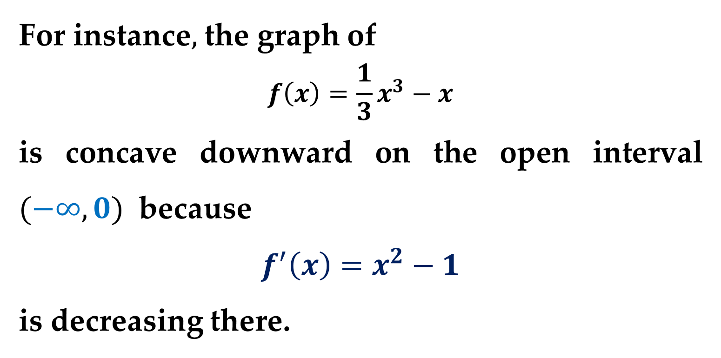
Example
For instance$,$ the graph of
$$f\left(x\right)=\frac{1}{3}x^{3}−x$$
is concave downward on the open interval $(−∞,0)$ because
$$f^{′}\left(x\right)=x^{2}−1$$
is decreasing there.

Slide 9
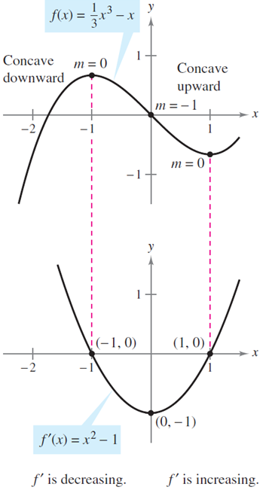

Example (continued)
Similarly$,$ the graph of
$$f\left(x\right)=\frac{1}{3}x^{3}−x$$
is concave upward on the
open interval $(0,∞)$
because
$$f^{′}\left(x\right)=x^{2}−1$$
is increasing on $(0,∞)$.

Slide 10
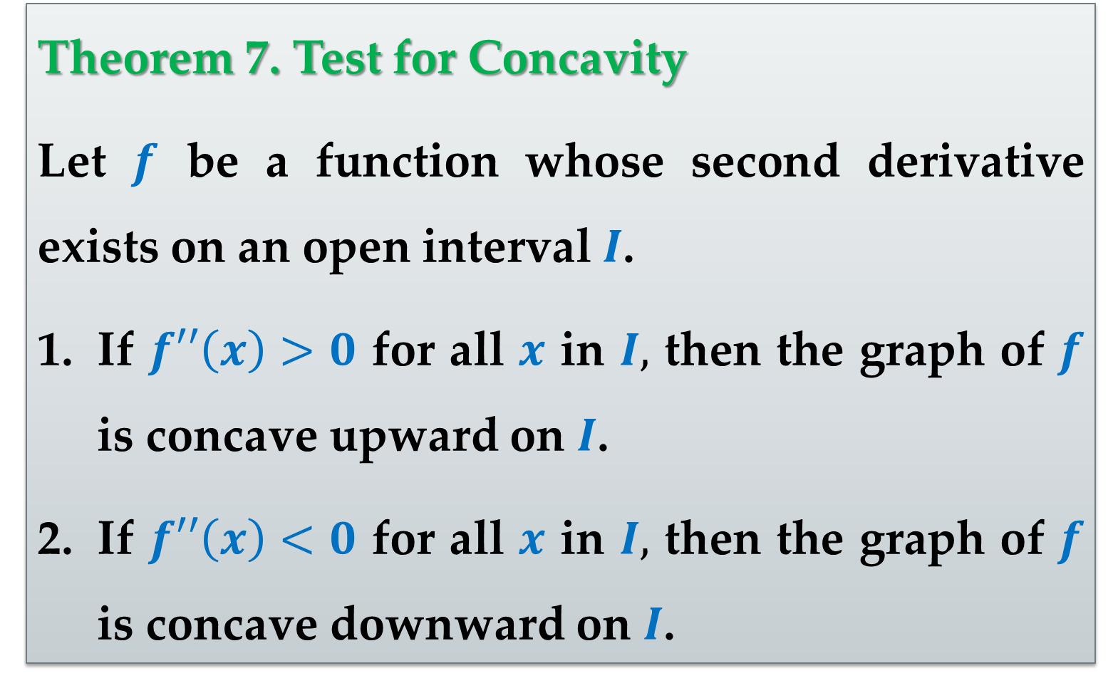
Theorem 7. Test for Concavity
Let $f$ be a function whose second derivative exists on an open interval $I$.
If $f′′\left(x\right)>0$ for all $x$ in $I,$ then the graph of $f$ is concave upward on $I$.
If $f′′\left(x\right)<0$ for all $x$ in $I,$ then the graph of $f$ is concave downward on $I$.

Slide 11
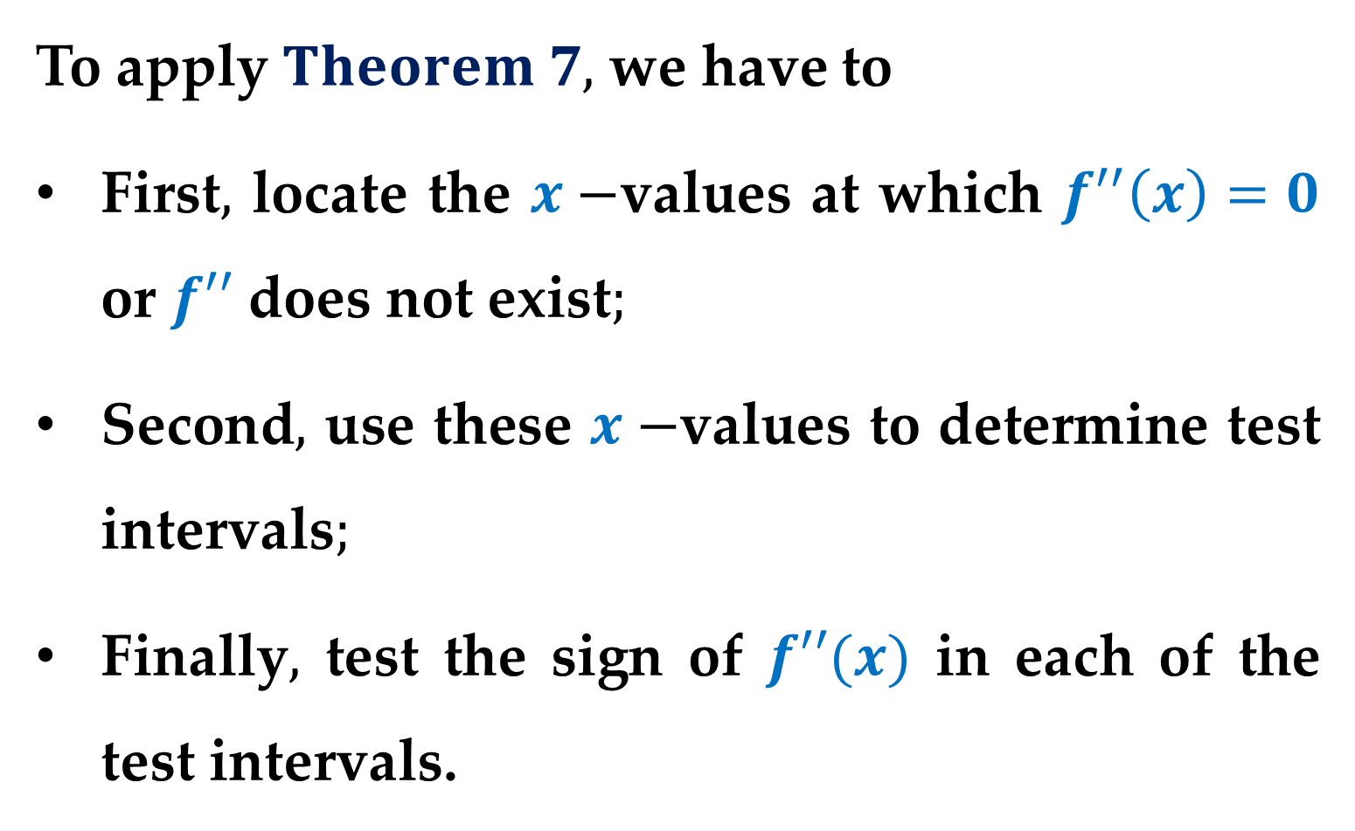
Guidelines for Using Theorem 7
To apply $Theorem 7,$ we have to
First$,$ locate the $x−$values at which $f^{′′}\left(x\right)=0$ or $f′′$ does not exist$;$
Second$,$ use these $x−$values to determine test intervals$;$
Finally$,$ test the sign of $f′′(x)$ in each of the test intervals.

Slide 12
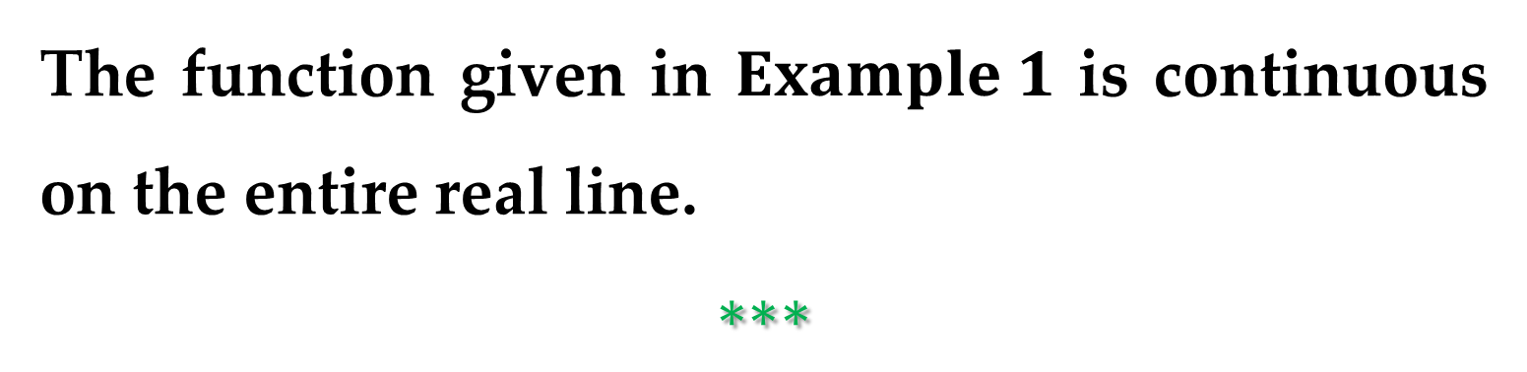
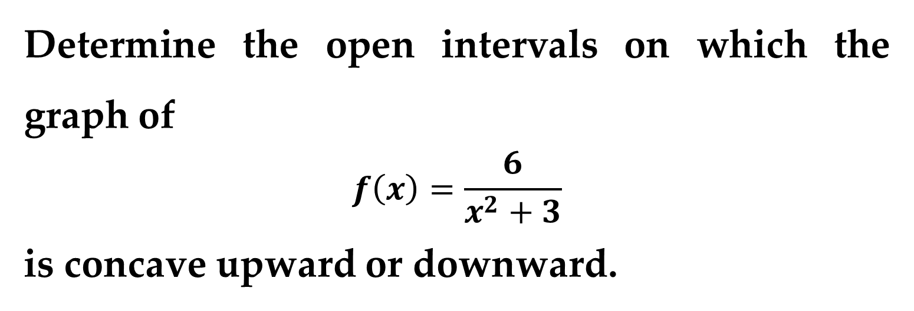
Example 1. Determining Concavity
Determine the open intervals on which the graph of
$$f\left(x\right)=\frac{6}{x^{2}+3}$$
is concave upward or downward.
The function given in $Example 1$ is continuous on the entire real line.
$$∗∗∗$$

Slide 13
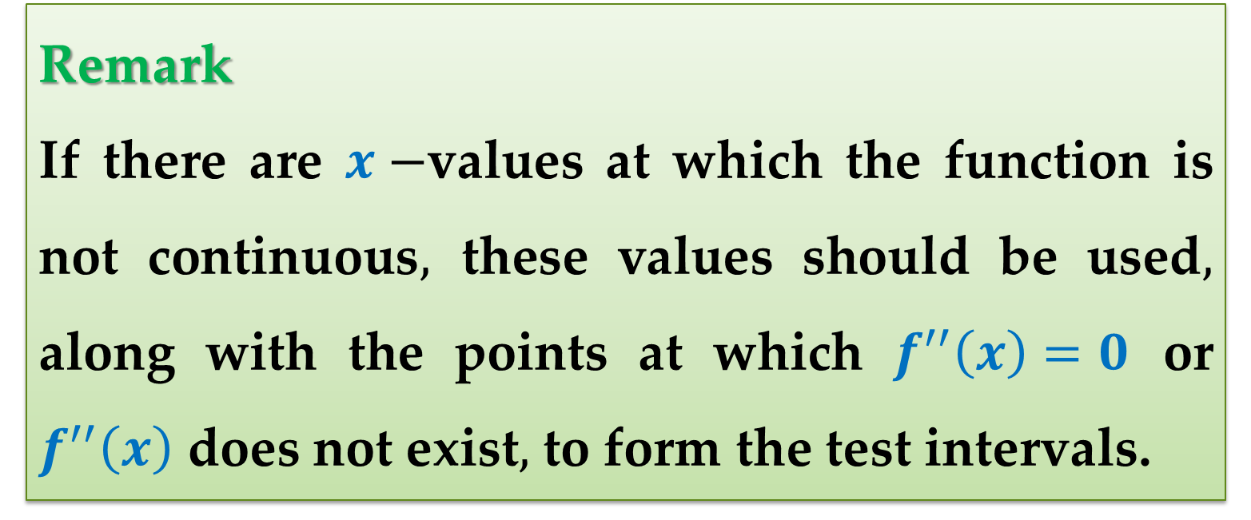
Remark
If there are $x−$values at which the function is not continuous$,$ these values should be used$,$ along with the points at which $f^{′′}\left(x\right)=0$ or $f^{′′}\left(x\right)$ does not exist$,$ to form the test intervals.

Slide 14
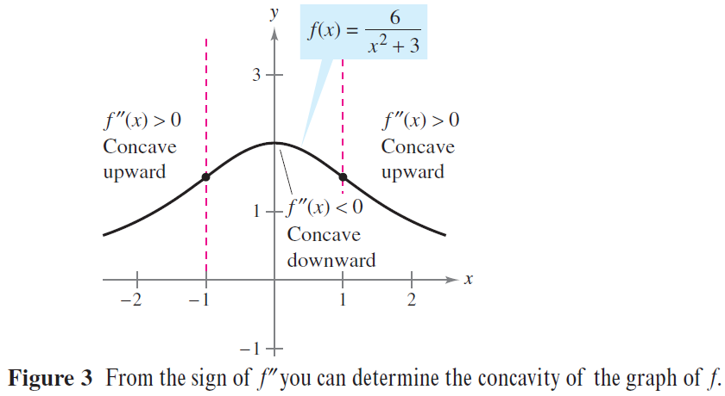
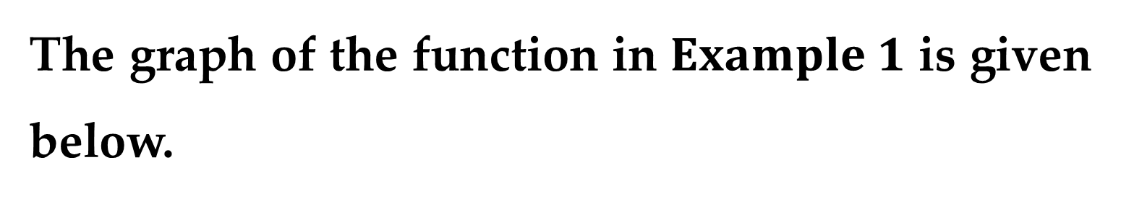
The graph of the function in $Example 1$ is given below.

Slide 15
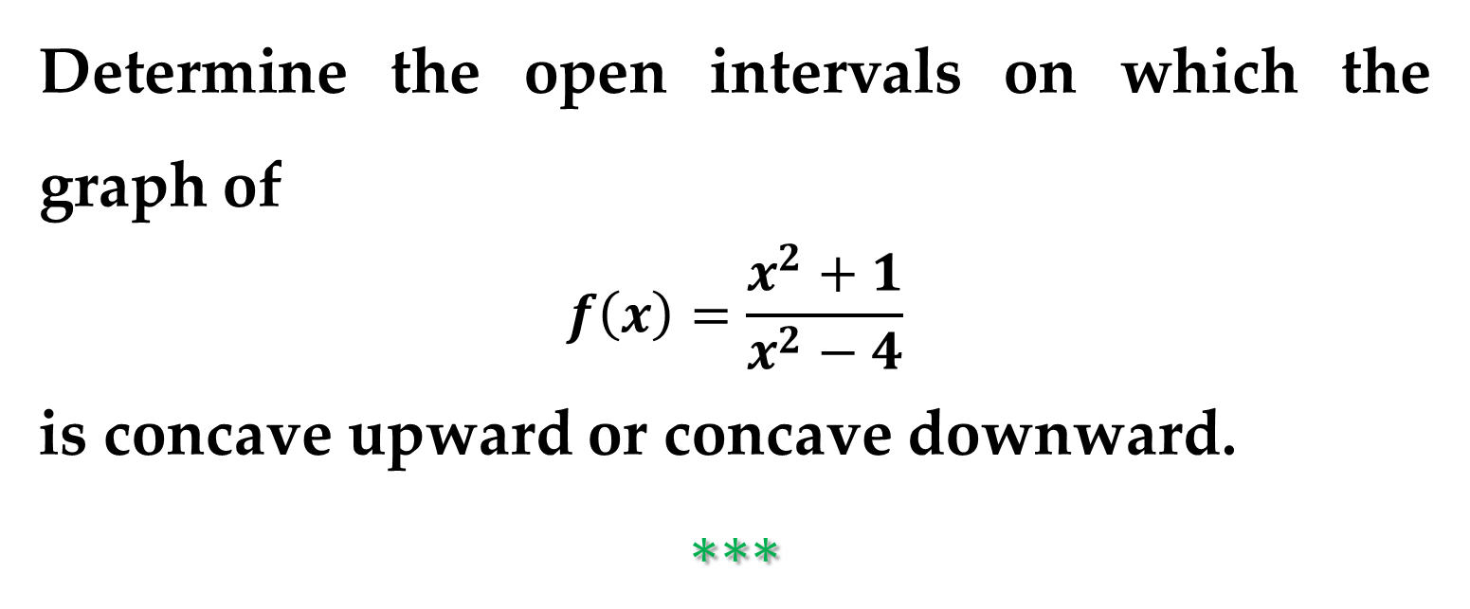
Example 2. Determining Concavity
Determine the open intervals on which the graph of
$$f\left(x\right)=\frac{x^{2}+1}{x^{2}−4}$$
is concave upward or concave downward.
$$∗∗∗$$

Slide 16
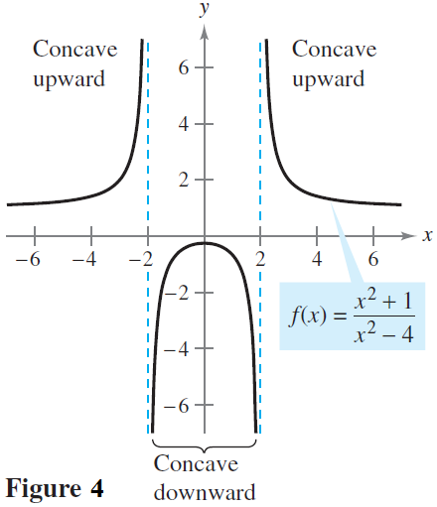
Example 2. (continued)
The graph of the function is shown in Figure 4.

Slide 17
Points of Inflection

Slide 18
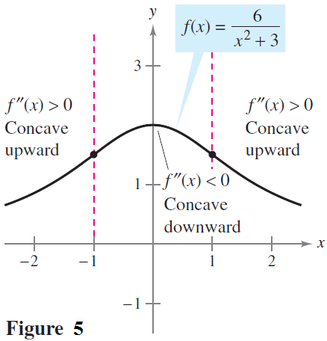
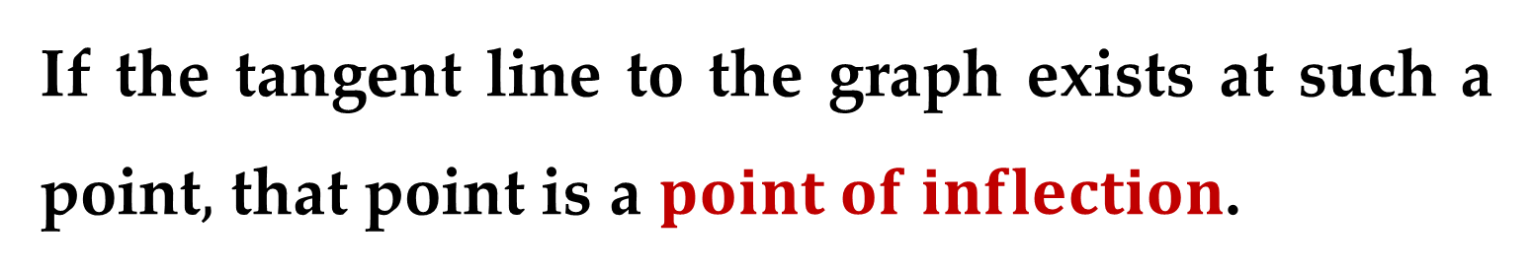
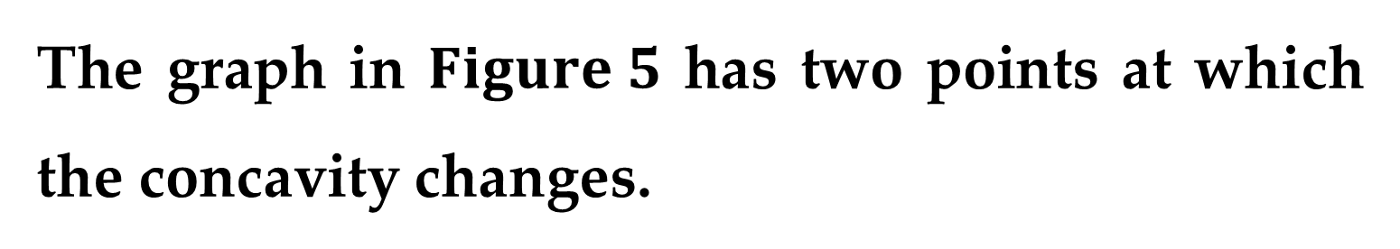
The graph in $Figure 5$ has two points at which the concavity changes.
If the tangent line to the graph exists at such a point$,$ that point is a $point of inflection$.

Slide 19
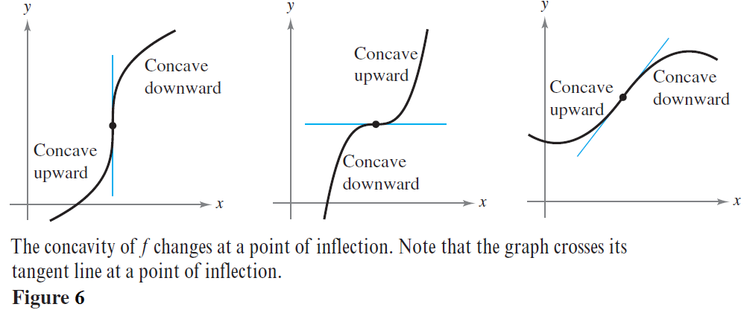
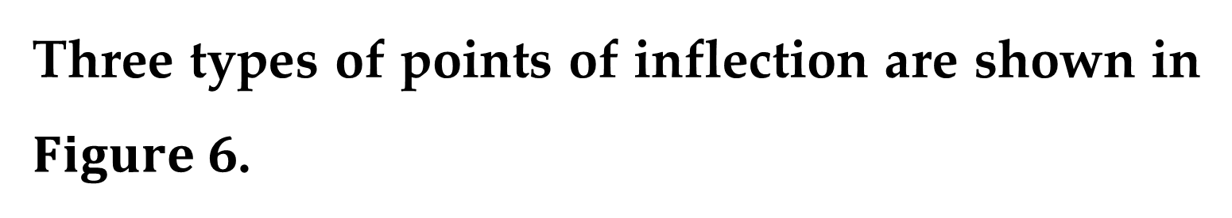
Three types of points of inflection are shown in $Figure 6$.

Slide 20
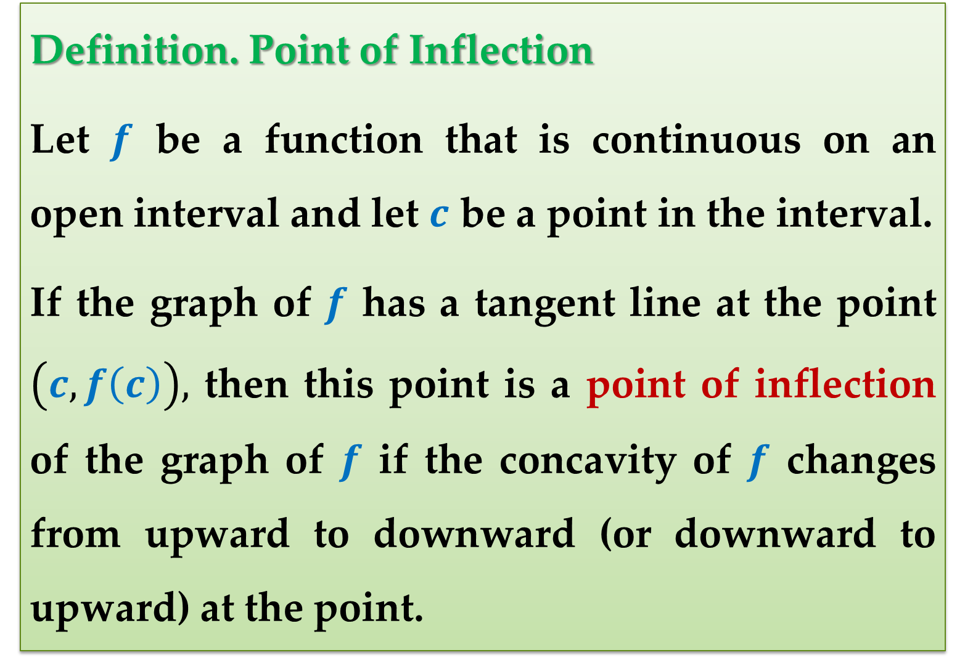
Definition. Point of Inflection
Let $f$ be a function that is continuous on an open interval and let $c$ be a point in the interval.
If the graph of $f$ has a tangent line at the point $\left(c,f\left(c\right)\right),$ then this point is a point of inflection of the graph of $f$ if the concavity of $f$ changes from upward to downward (or downward to upward) at the point.

Slide 21
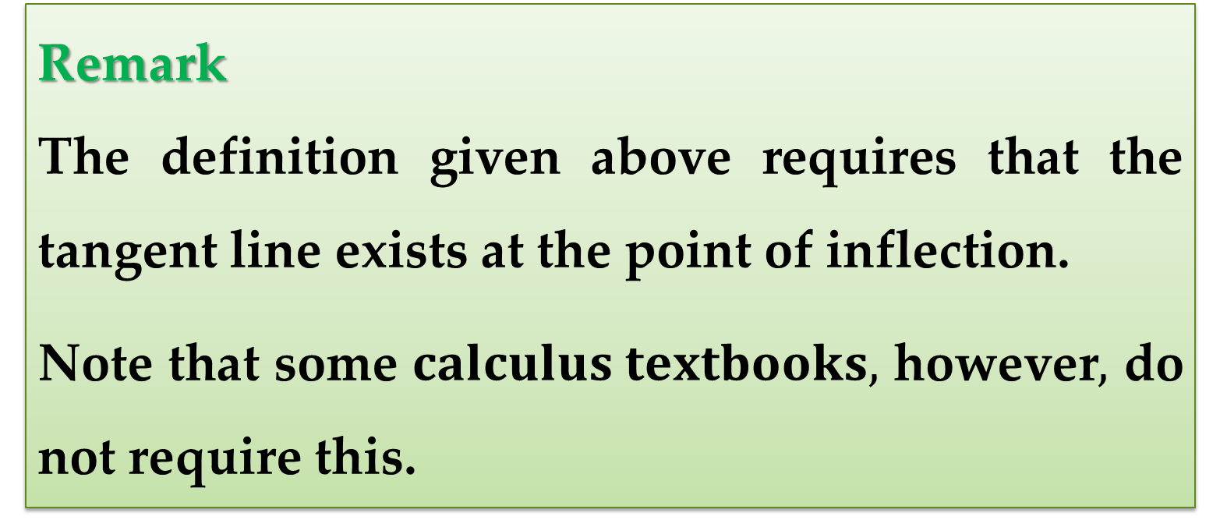
Remark
The definition given above requires that the tangent line exists at the point of inflection.
Note that some $calculus textbooks,$ however$,$ do not require this.

Slide 22
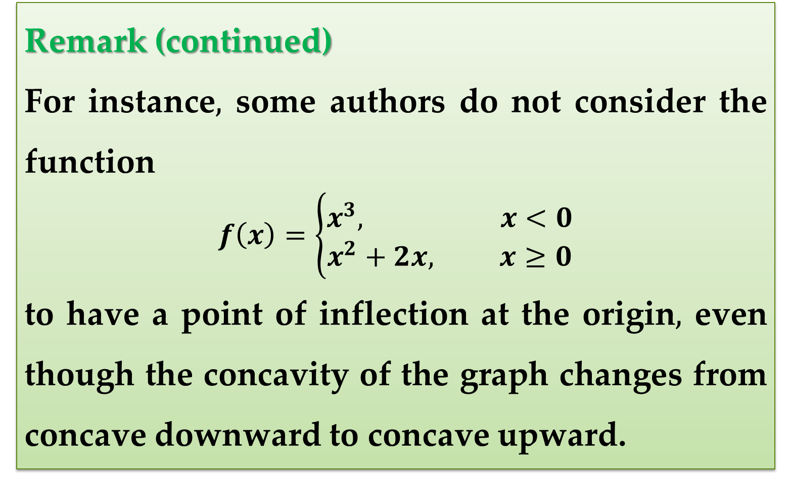
Remark (continued)
For instance$,$ some authors do not consider the function
$$f\left(x\right)=\left\{\begin{aligned}x^{3}, x<0 \\ &x^{2}+2x, x≥0\end{aligned}\right.$$
to have a point of inflection at the origin$,$ even though the concavity of the graph changes from concave downward to concave upward.

Slide 23
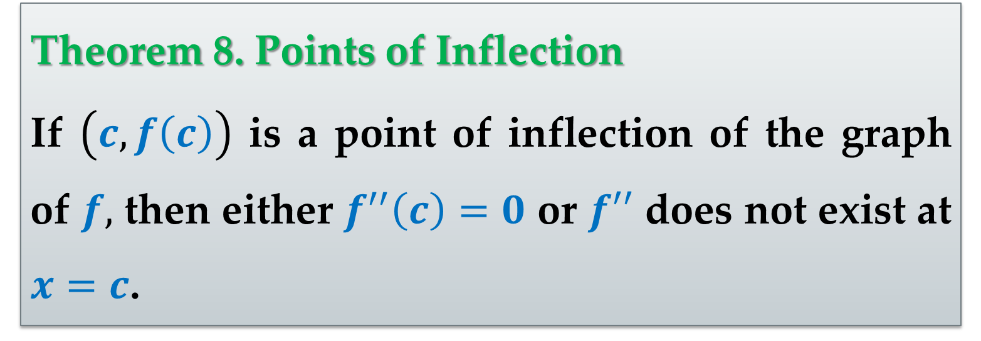
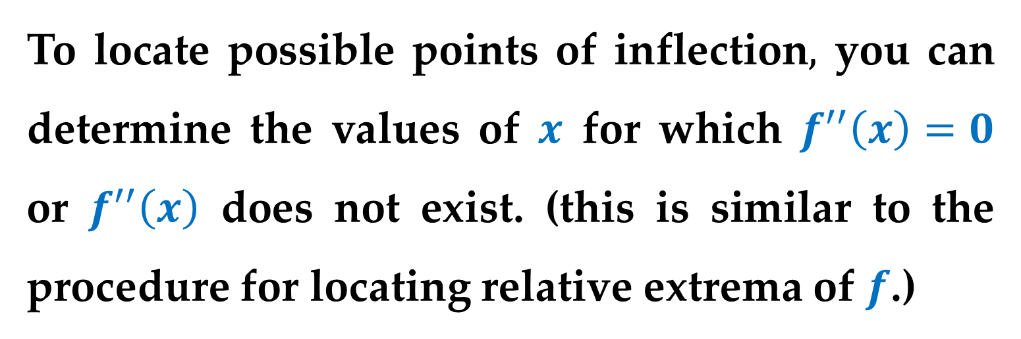
To locate possible points of inflection$,$ you can determine the values of $x$ for which $f^{′′}\left(x\right)=0$ or $f^{′′}\left(x\right)$ does not exist. (this is similar to the procedure for locating relative extrema of $f$.)
Theorem 8. Points of Inflection
If $\left(c,f\left(c\right)\right)$ is a point of inflection of the graph of $f,$ then either $f^{′′}\left(c\right)=0$ or $f′′$ does not exist at $x=c$.

Slide 24
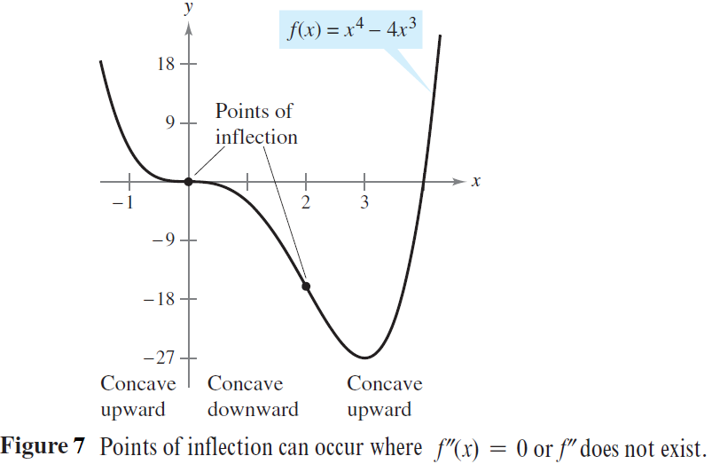
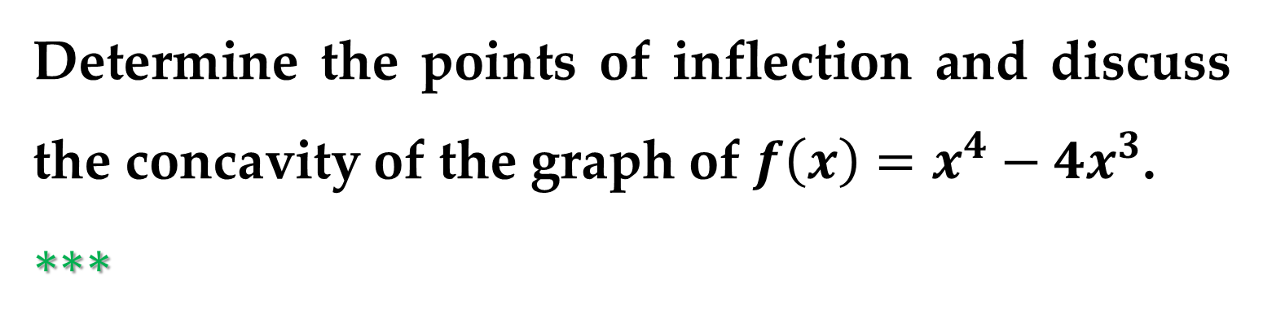
Example 3. Finding Points of Inflection
Determine the points of inflection and discuss the concavity of the graph of $f\left(x\right)=x^{4}−4x^{3}$.
$∗∗∗$

Slide 25
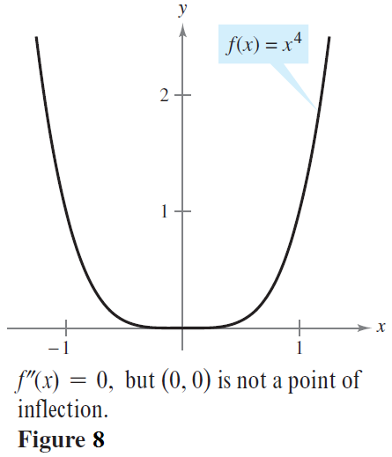
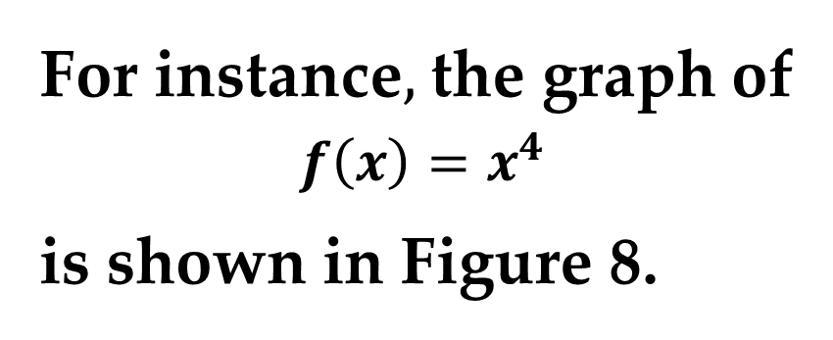
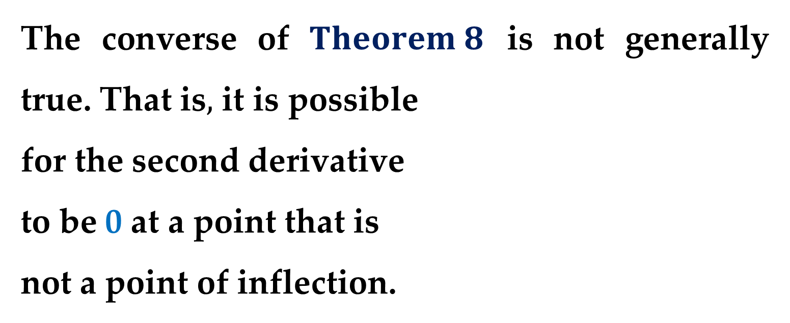
Remark
The converse of $Theorem 8$ is not generally true. That is$,$ it is possible
for the second derivative
to be 0 at a point that is
not a point of inflection.
For instance$,$ the graph of
$$f\left(x\right)=x^{4}$$
is shown in Figure 8.

Slide 26
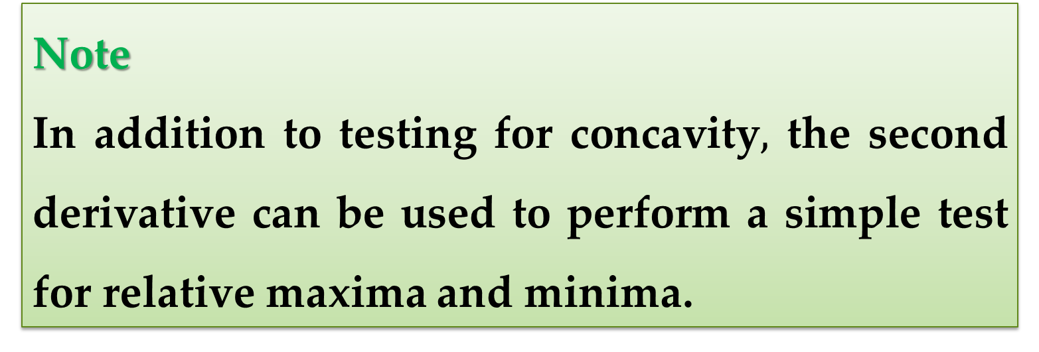
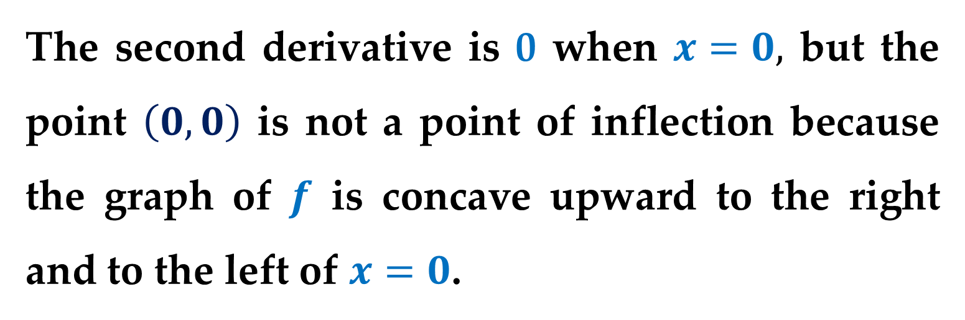
The second derivative is 0 when $x=0,$ but the point $\left(0,0\right)$ is not a point of inflection because the graph of $f$ is concave upward to the right and to the left of $x=0$.
Note
In addition to testing for concavity$,$ the second derivative can be used to perform a simple test for relative maxima and minima.

Slide 27
The Second Derivative Test

Slide 28
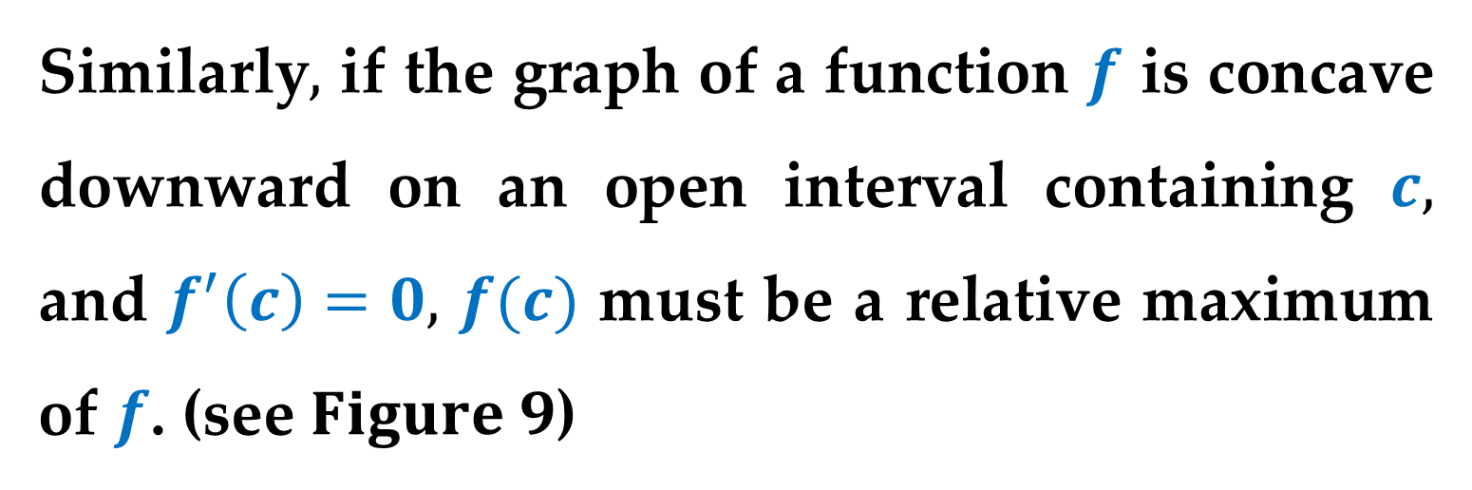
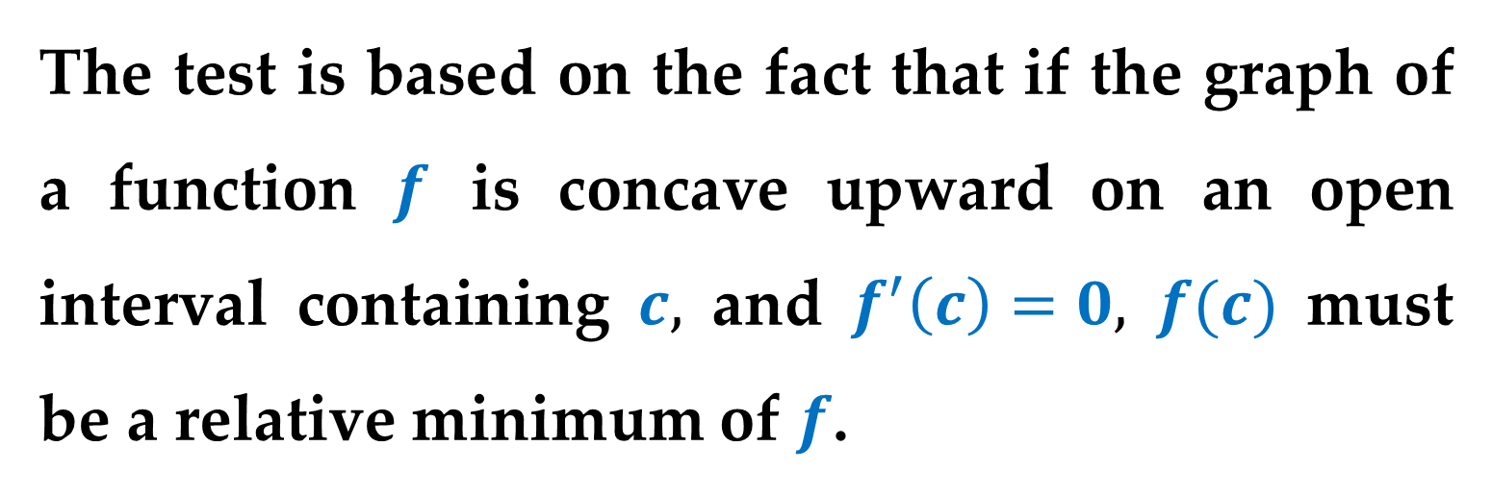
The test is based on the fact that if the graph of a function $f$ is concave upward on an open interval containing $c,$ and $f^{′}\left(c\right)=0,$ $f(c)$ must be a relative minimum of $f$.
Similarly$,$ if the graph of a function $f$ is concave downward on an open interval containing $c,$ and $f^{′}\left(c\right)=0,$ $f(c)$ must be a relative maximum of $f$. (see $Figure 9$)

Slide 29
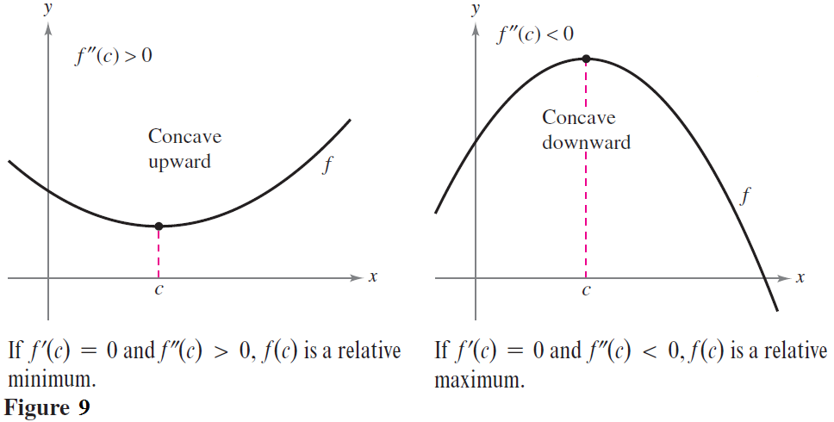

Slide 30
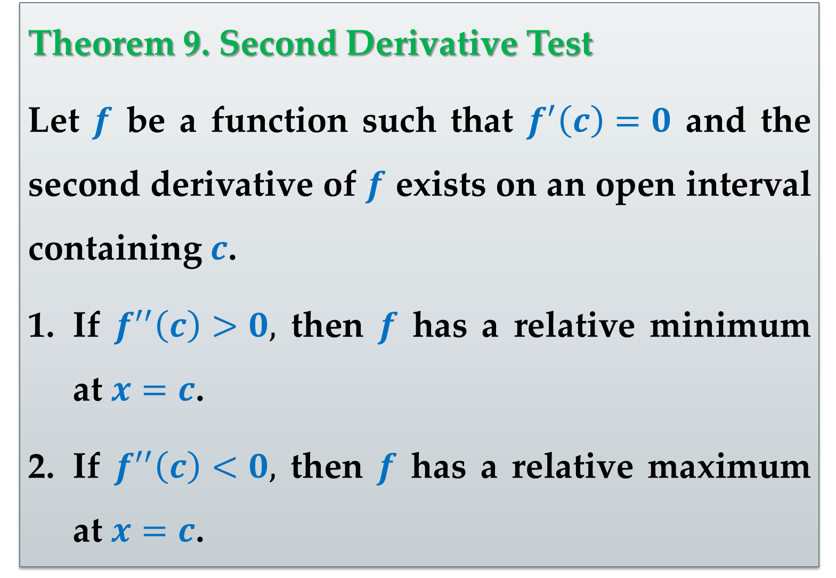
Theorem 9. Second Derivative Test
Let $f$ be a function such that $f^{′}\left(c\right)=0$ and the second derivative of $f$ exists on an open interval containing $c$.
If $f^{′′}\left(c\right)>0,$ then $f$ has a relative minimum at $x=c$.
If $f^{′′}\left(c\right)<0,$ then $f$ has a relative maximum at $x=c$.

Slide 31
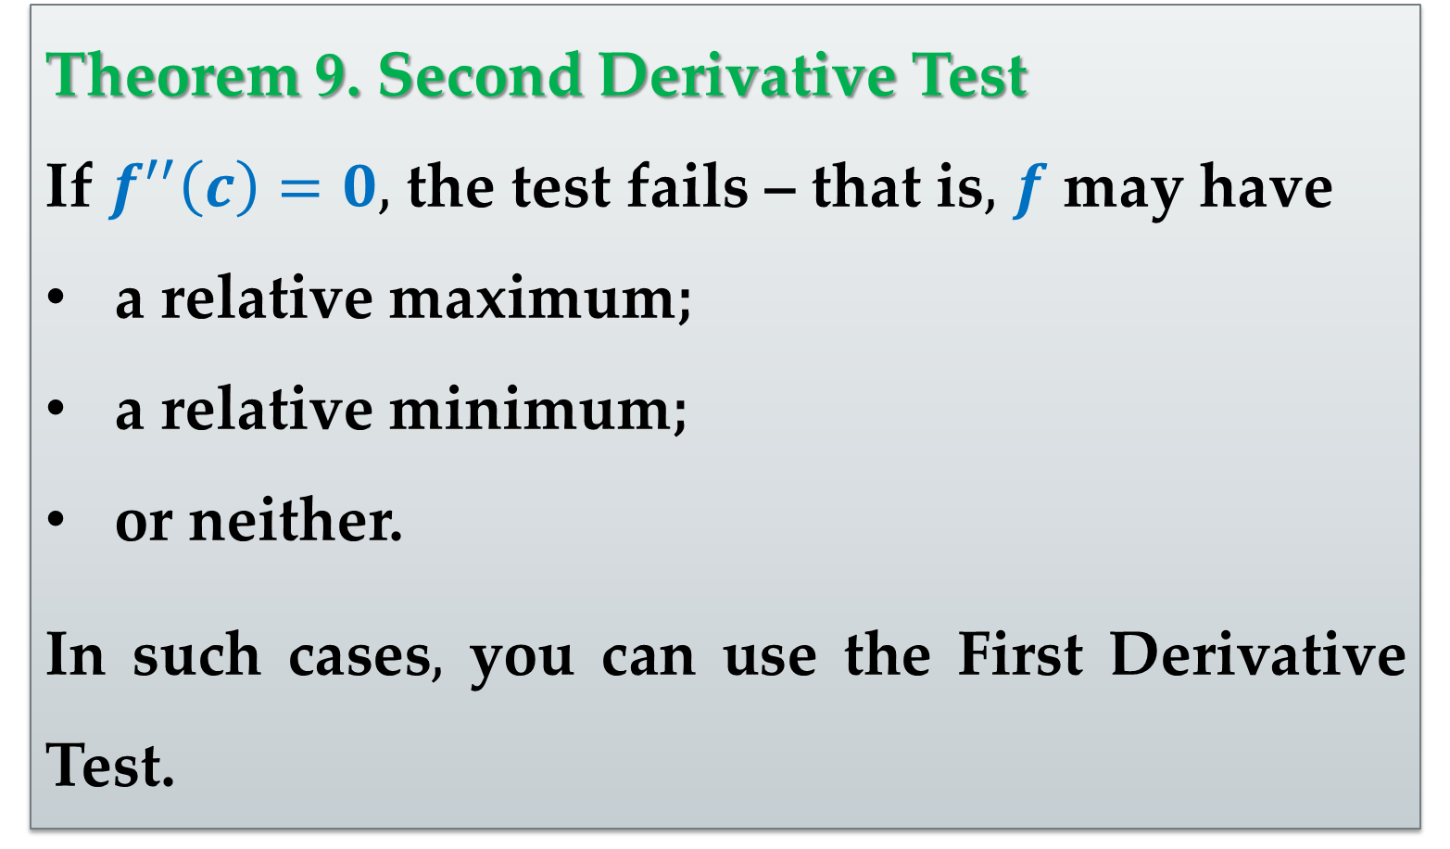
Theorem 9. Second Derivative Test
If $f^{′′}\left(c\right)=0,$ the test fails – that is$,$ $f$ may have
a relative maximum;
a relative minimum;
or neither.
In such cases$,$ you can use the First Derivative Test.

Slide 32
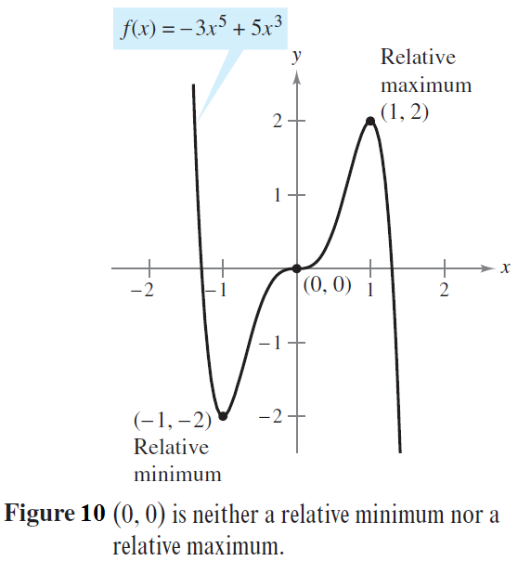
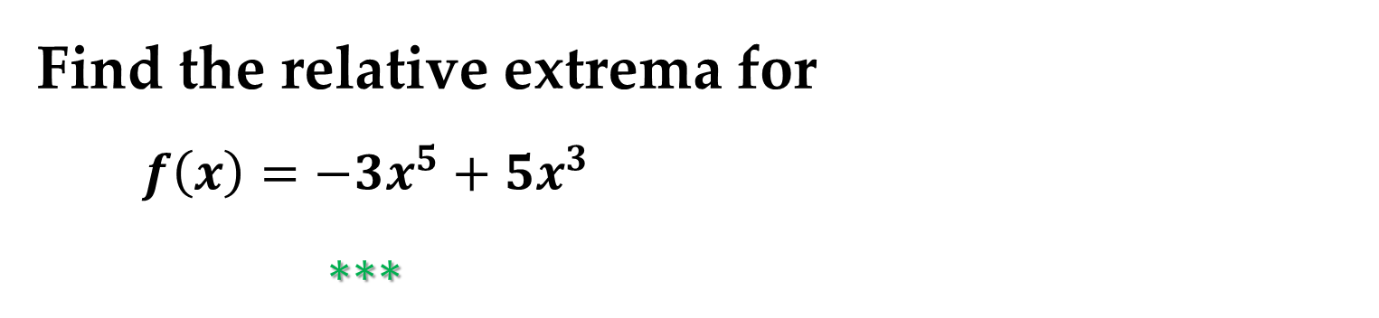
Example 4. Using the Second Derivative Test
Find the relative extrema for
$f\left(x\right)=−3x^{5}+5x^{3}$
$∗∗∗$

Slide 33
Thank you for attention

